Slide 1




PulsNet
Smart Shoes for Blind People
AI-Powered Navigation System for Visually Impaired

Slide 2


PulsNet
01
Mahmudkhon Usmonov
Project lead, Arduino programming, used ...
.....
04
Shipulin Arslan
Member Tasks within Project
Arduino programming, pressure sensor integration
worked with types of sounds
07
Fyodor Amanov
Wokwi Simulation setup, initial architechure integration, hardware
10
Muhammad Zubair Islam
Research Supervisor

Slide 3
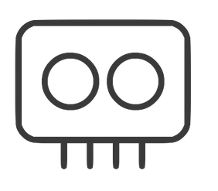


PulsNet
My Role & Responsibilities
Solution 01
Led overall project development, hardware architecture, and firmware design.
Solution 02
Integrated sensor systems and implemented advanced real-time processing algorithms.
Usmonov Mahmudkhon23013088
Solution 03
Designed user feedback mechanisms and display control.

Slide 4
Hardware Architecture
1. Developed a functional hardware system featuring robust sensing and feedback capabilities.
2. Utilized four HC-SR04 sensors for comprehensive detection. Incorporated dual vibration motors to assist in navigation.
3.Included 7-segment displays, an I2C LCD, and RGB lights for clear and effective information display.
Usmonov Mahmudkhon

Slide 5
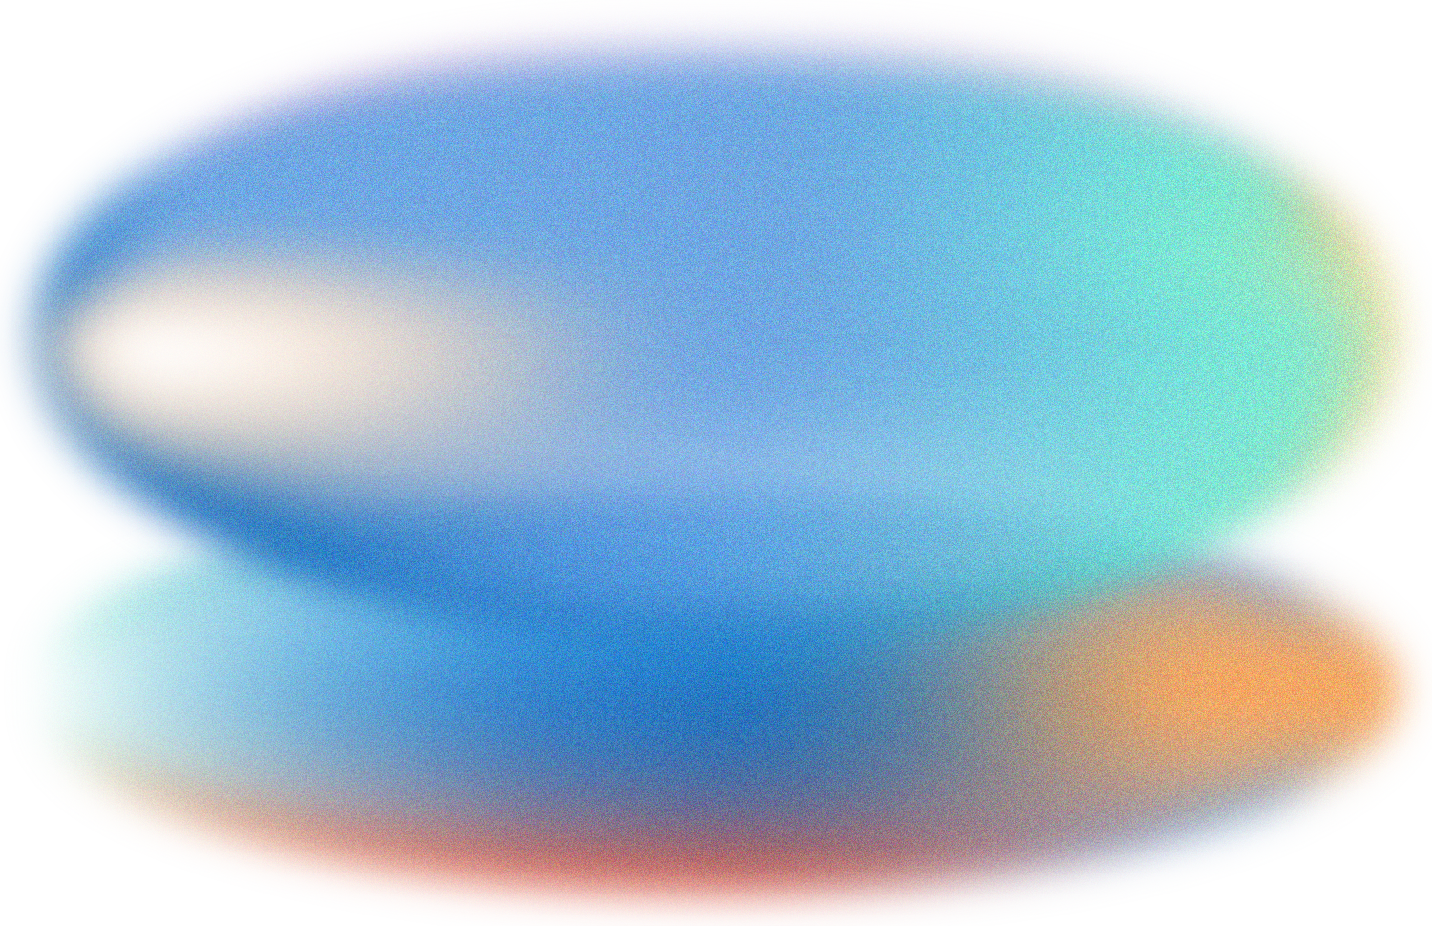
Core Features
1
2
3
4
Multi-Sensor Integration
Intelligent Zone Detection
Countdown Timer System
Emergency System
Usmonov Mahmudkhon

Slide 6
Technical Achievements
~Reduced Arduino sketch size to ~800+ lines using memory optimization techniques.
~ Implemented a moving-average plus outlier detection filter for reliable sensor data.
~Real-time directional haptic feedback for obstacle proximity.
~
~Optimized real-time processing at 100 ms sensor intervals
Usmonov Mahmudkhon

Slide 7
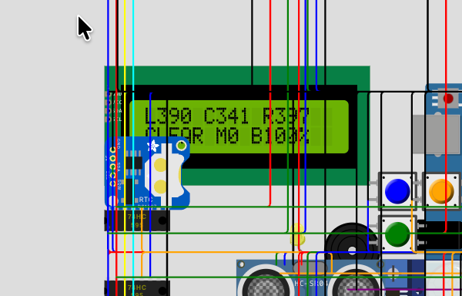
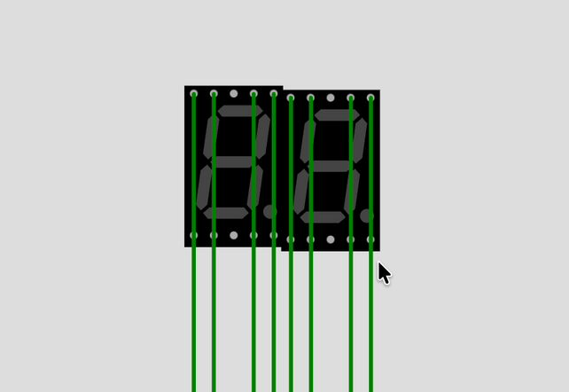
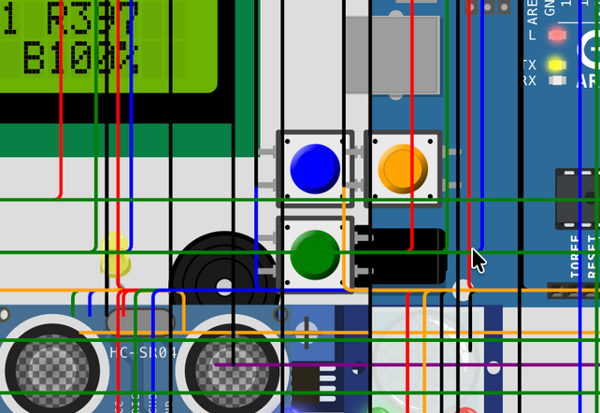
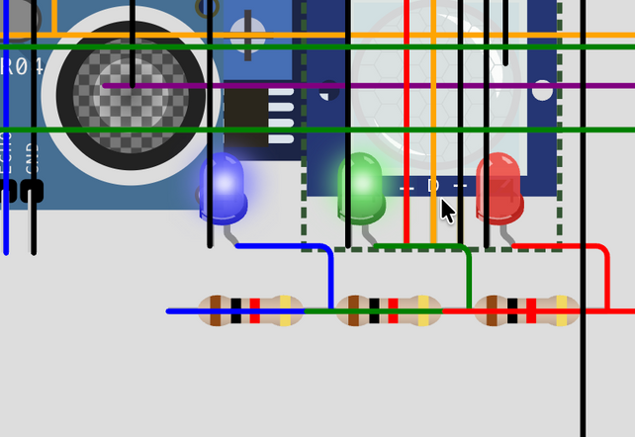
PulsNet
LCD DISPLAY
7-SEGMENT
Componenets
PUSH BUTTONS
INDICATOR LED
Usmonov Mahmudkhon

Slide 8
Links
Project-website:
https://iot-doc.netlify.app
Github:
https://github.com/UsmanovMahmudkhan/Iot-doc
Documentation:
https://github.com/UsmanovMahmudkhan/Iot-doc/blob/main/README.md
Live-demo:
https://wokwi.com/projects/449468602181139457
Api-reference:
https://iot-doc.netlify.app/docs/api
Usmonov Mahmudkhon

Slide 9



PulsNet
Solution 01
Sound feedback system
Solution 02
Pressure sensor integration (HX711), slip detection logic
Shipulin
Arslan
25040200
Solution 03
Non-blocking audio alerts, pressure data visualization.

Slide 10
Hardware Architecture
1. Developed a pressure-based safety subsystem using an HX711 load cell amplifier to monitor foot–ground contact stability in real time.
2. Implemented slip detection logic based on sudden pressure drops and loss of stable contact, enabling early detection of slippery surfaces.
3. Designed an adaptive sound feedback system with non-blocking audio patterns to communicate obstacle proximity, slip warnings, and emergency states without visual dependency.
Shipulin
Arslan

Slide 11
Core Features
1
2
3
4
Pressure-Based Sensing
Slip Detection Logic
Adaptive Sound Feedback
Non-Blocking Safety Alerts
Shipulin Arslan

Slide 12
Technical Achievements
~ Implemented a pressure-based slip detection system using HX711 with real-time analysis of foot–ground contact stability.
~ Designed a non-blocking sound feedback architecture using millis() to ensure continuous sensing and immediate alert response.
~ Developed adaptive audio patterns where sound frequency dynamically changes based on distance, surface condition, and system state.
~ Visualized real-time pressure data and slip events using Serial Plotter for validation and debugging.
Shipulin
Arslan

Slide 13
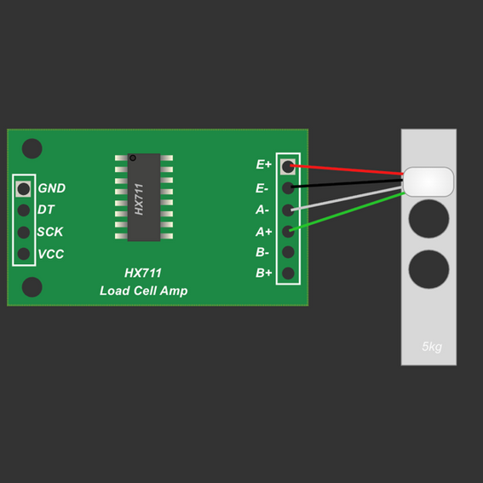

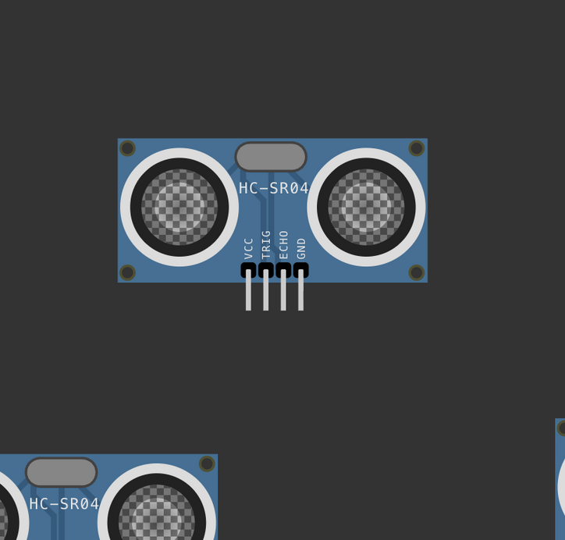
PulsNet
TX711
BUZZER
Componenets
Shipulin
Arslan
ULTRASONIC SENSOR

Slide 14
Links
Project-website:
https://github.com/arslan1t//iotproject-my-part-
Documentation:
https://arslan1t.github.io/iot-project/
Live-demo:
https://wokwi.com/projects/449468602181139457
Api-reference:
https://iot-doc.netlify.app/docs/api
Sipulin
Arslan

Slide 15



PulsNet
Initial architechure
Ultrasonic detector and Lidar simulations
Extended architechure
Photoresistor, motion sensor
Fyodor Amanov 25040181
Hardware experiments
Implementation with ESP32, ultrasonic detector

Slide 16
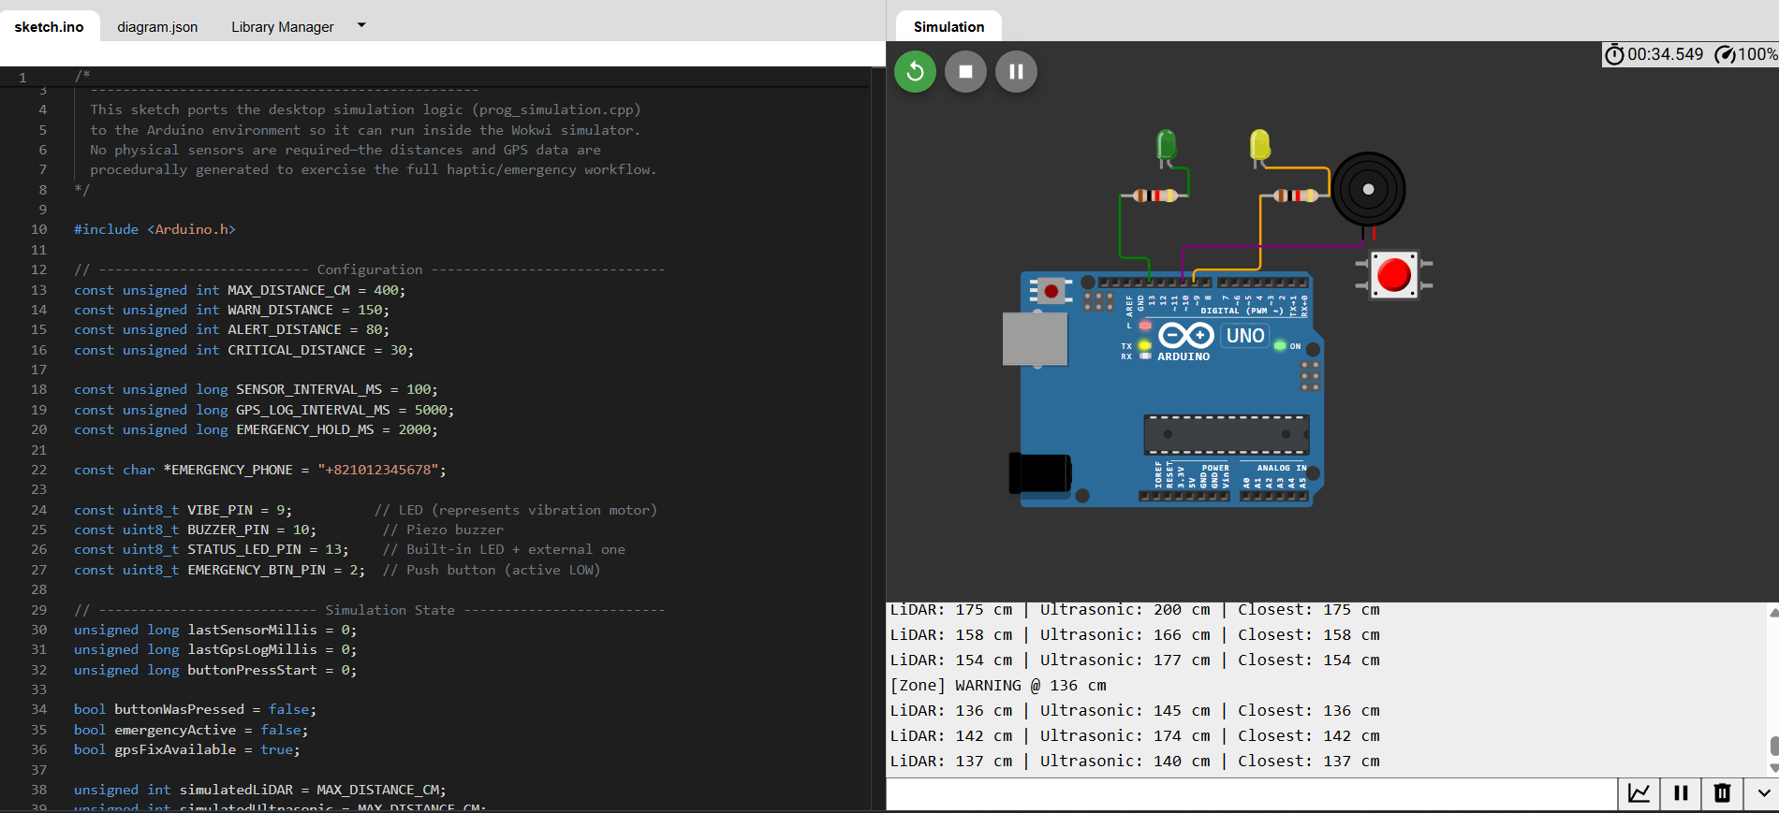
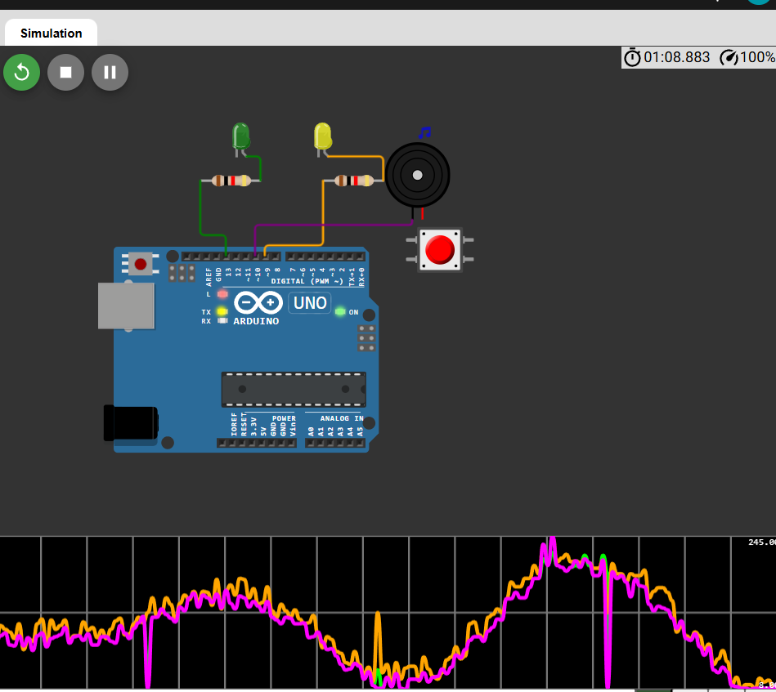
PulsNet
Initial architechure
Ultrasonic detector and Lidar simulations

Slide 17
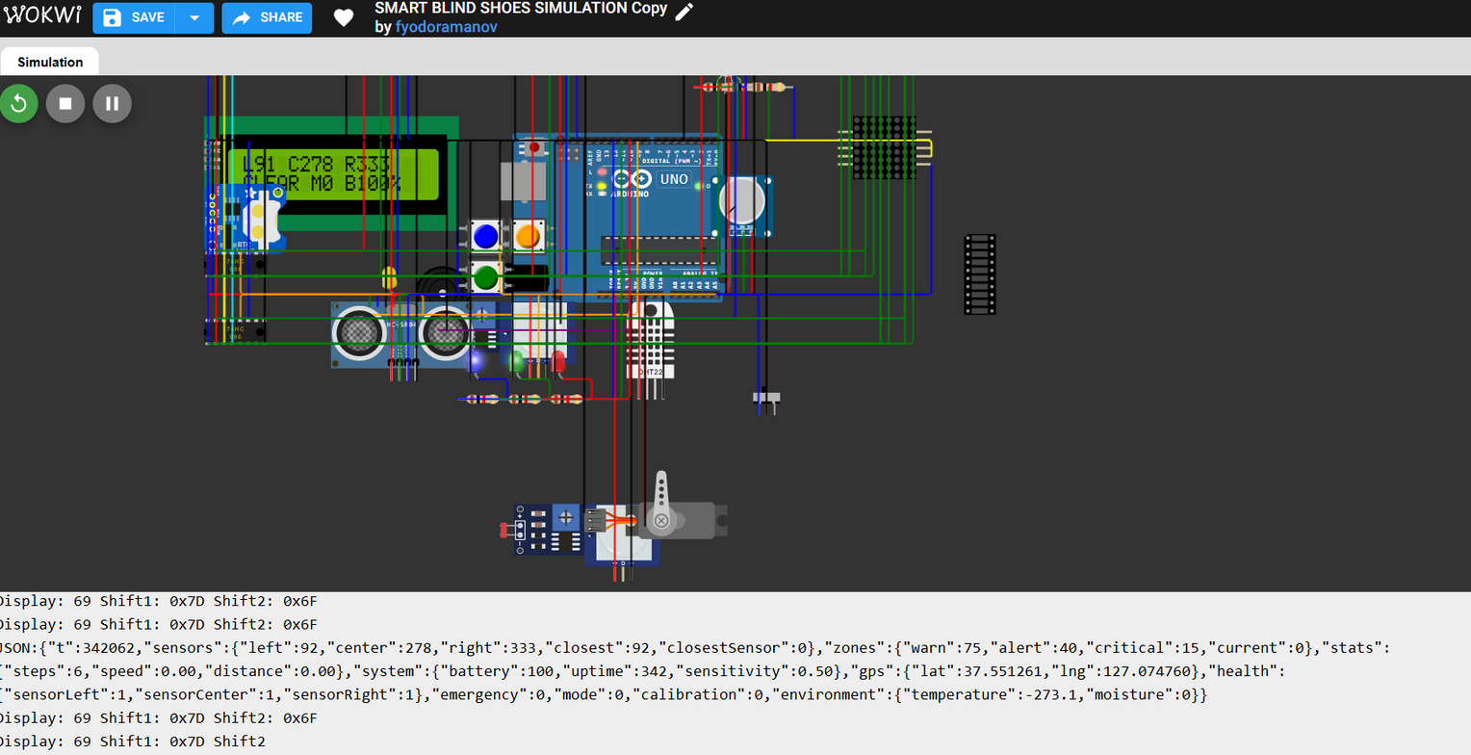
PulsNet
Extended architechure
Photoresistor, high accuracy motion sensor, moisture/temperature sensor

Slide 18
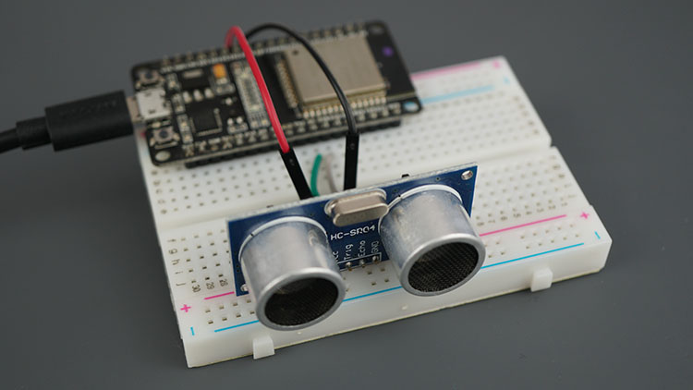
PulsNet
Hardware experiments
Implementation with ESP32, ultrasonic detector

Slide 19
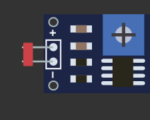
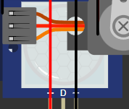
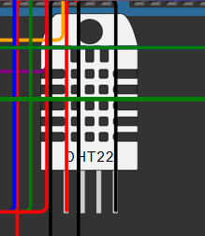
PulsNet
PHOTORESISTOR
MOTION DETECTOR
Componenets
Fyodor Amanov
TEMPERATURE/MOISTURE SENSOR

Slide 20
PulsNet
Website: https://fyodoramanov1.github.io/Iot-doc/
Live demo: https://wokwi.com/projects/450675544433895425
Fyodor Amanov

Slide 21
